Slide 1
Scuola secondaria di 1^ grado
Cosmo Guastella – Misilmeri
A. S. 2013 – 2014
Which activities have aroused
the interest of students

Slide 2
How we try to better interest in students
Engaging students in active forms of learning.
By creation of final products. The students can build their knowledge in a close interdependence between "doing" and "learning." The final products represent the knowledge that students have acquired.
Referring to the experiences that students live
Learning by experimental and laboratorial method.

Slide 3
Grandparents
Day

Slide 7
Seminar on drug addiction Misilmeri 19/11/2013

Slide 8
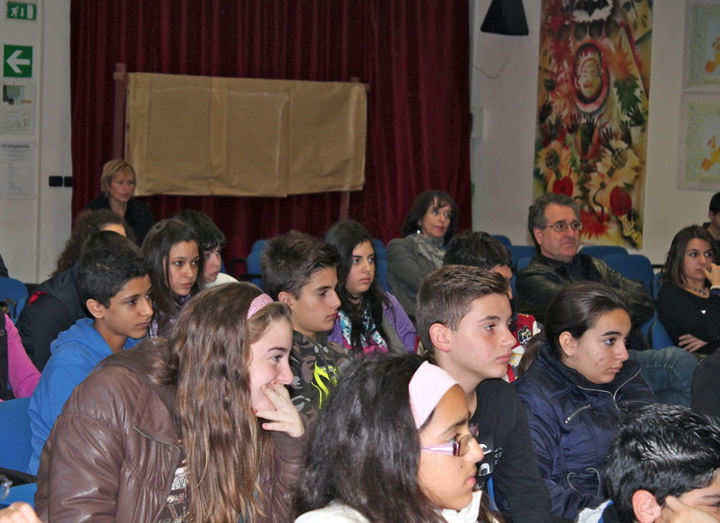
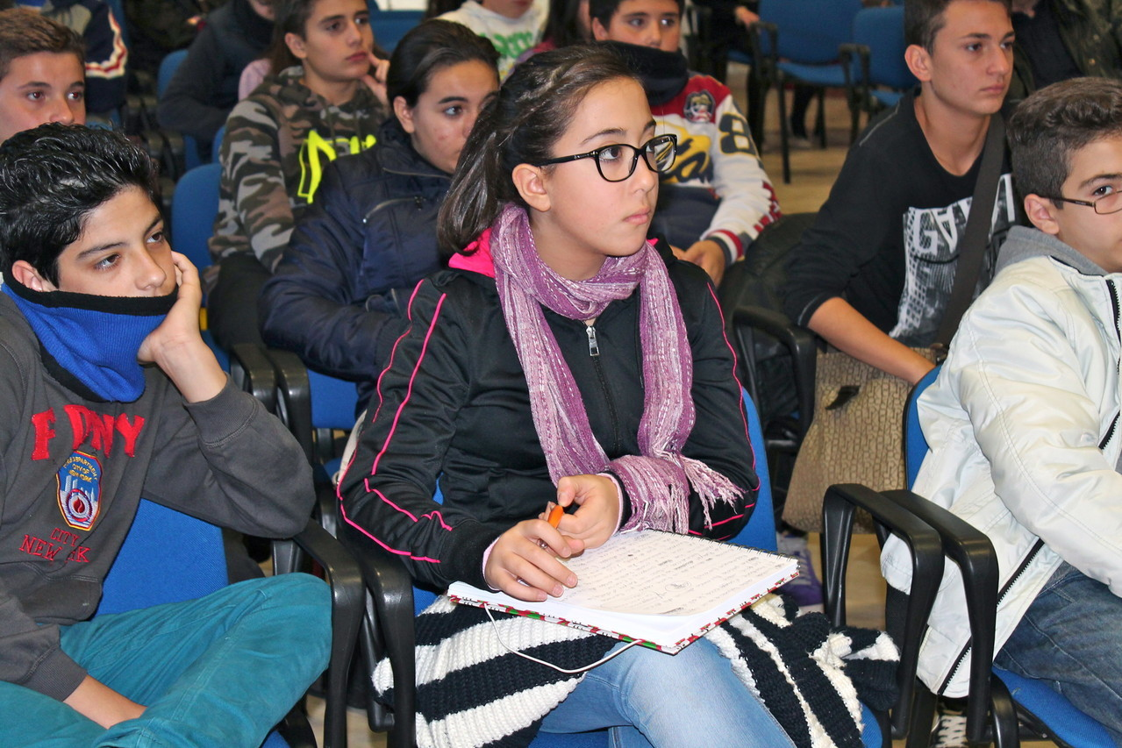

Slide 9
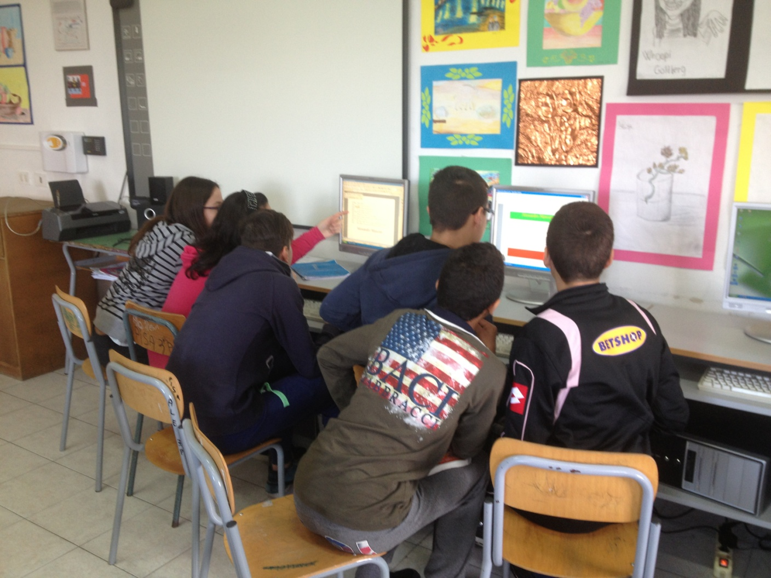
Research of information

Slide 10
Seminar among peers Portella di Mare 18/12/2013

Slide 11
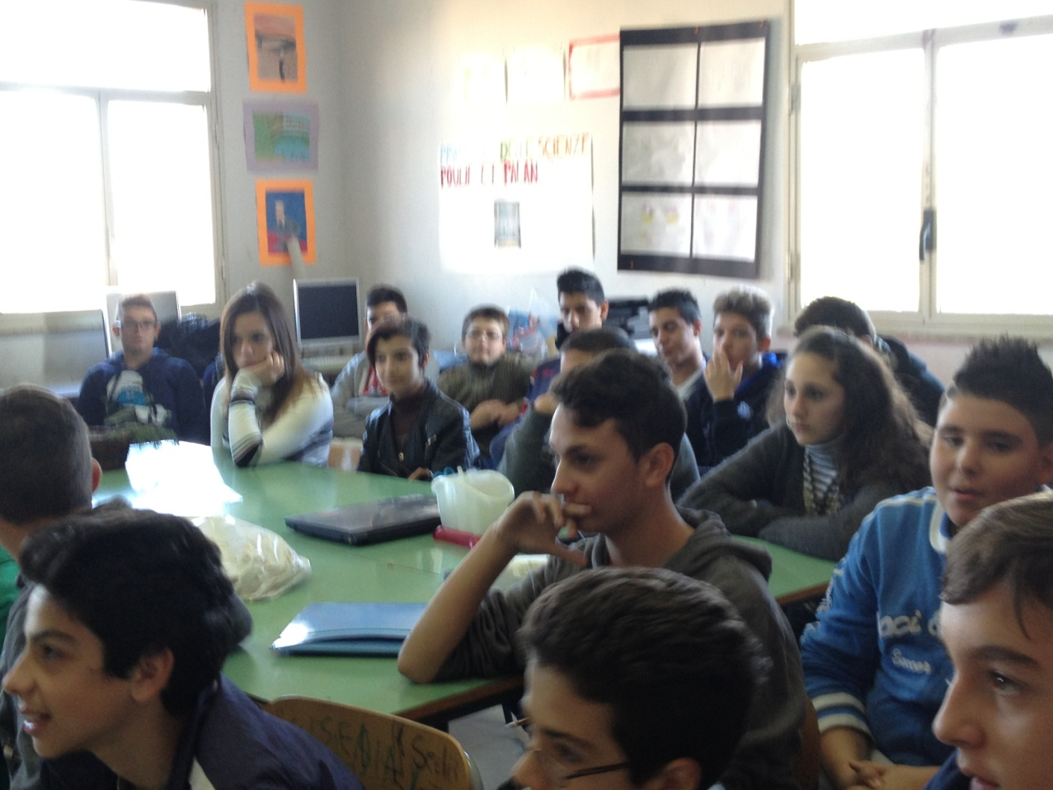

Slide 12
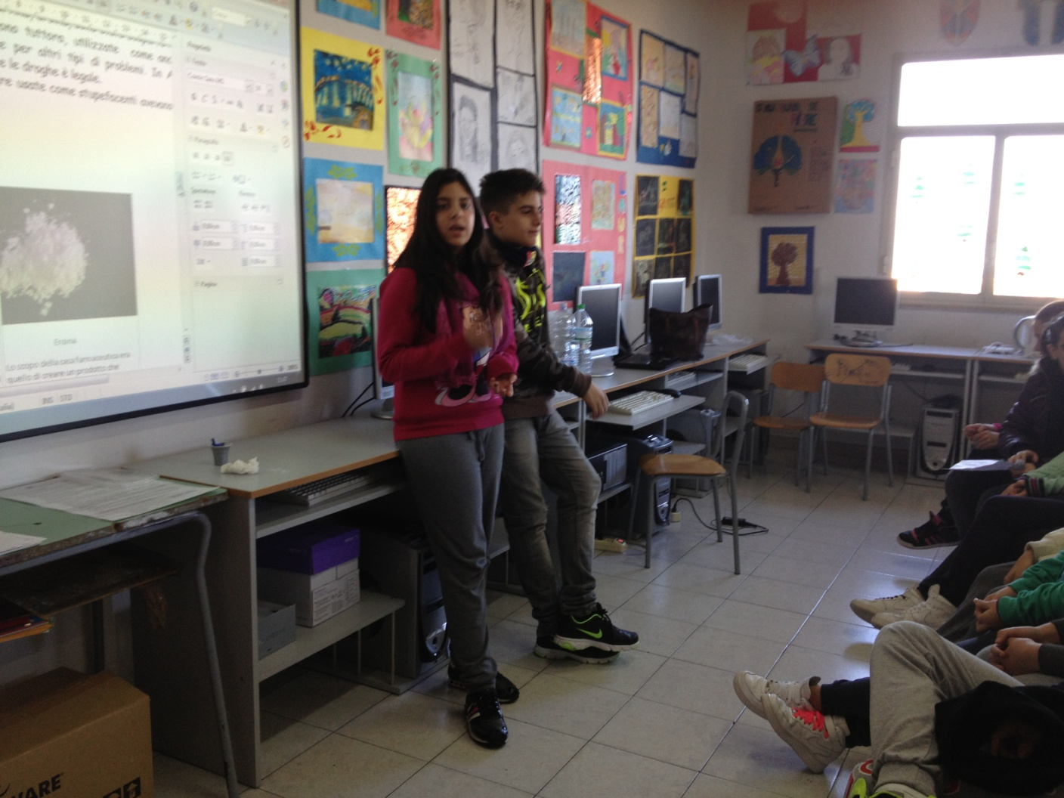
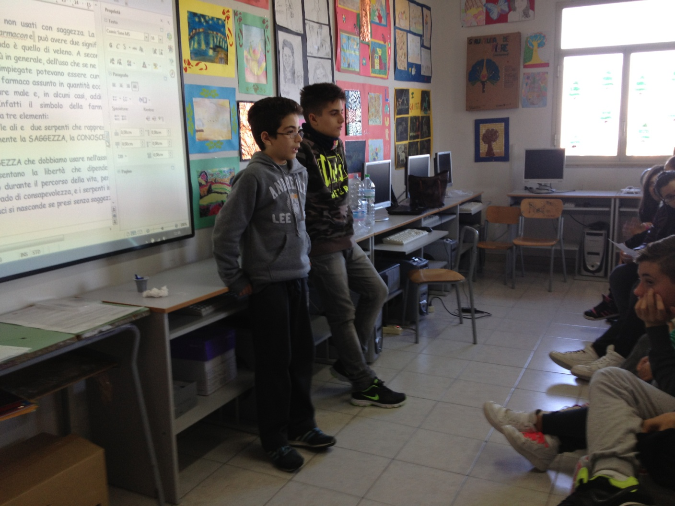
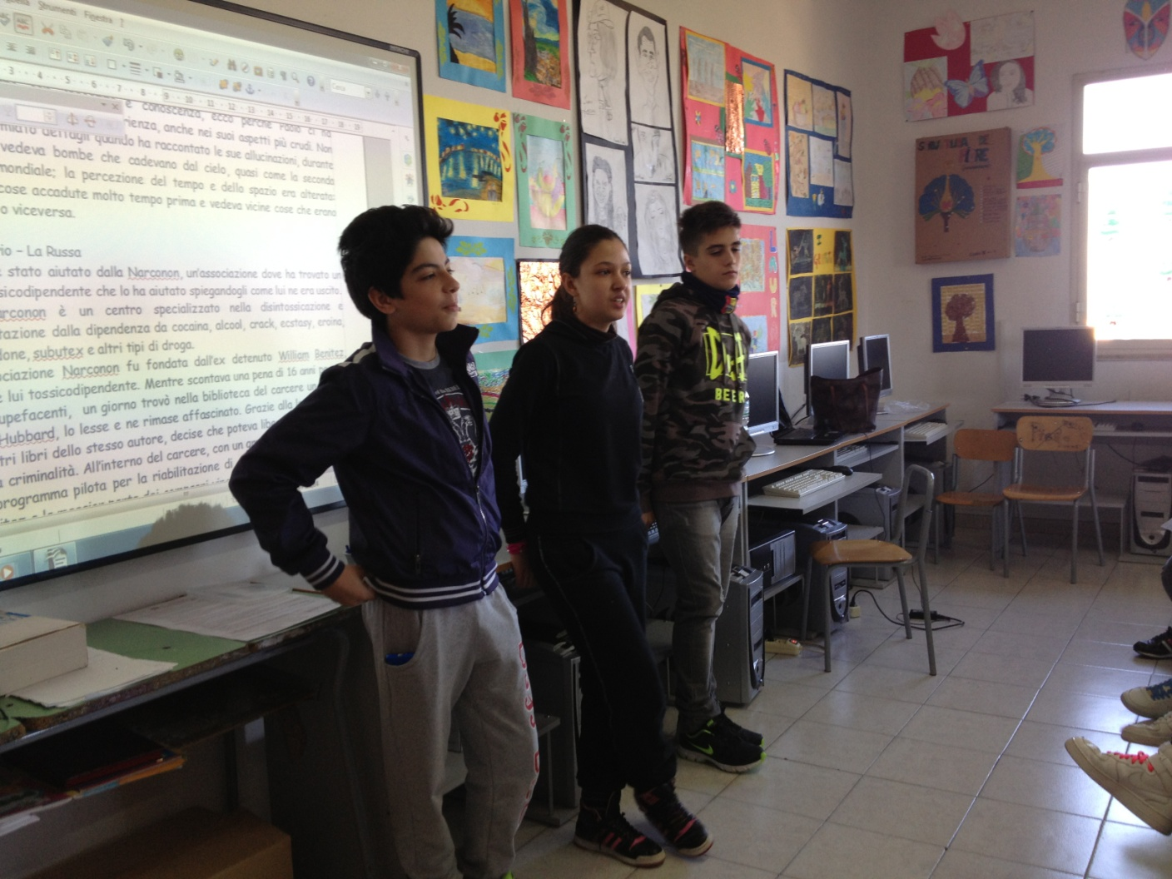

Slide 13
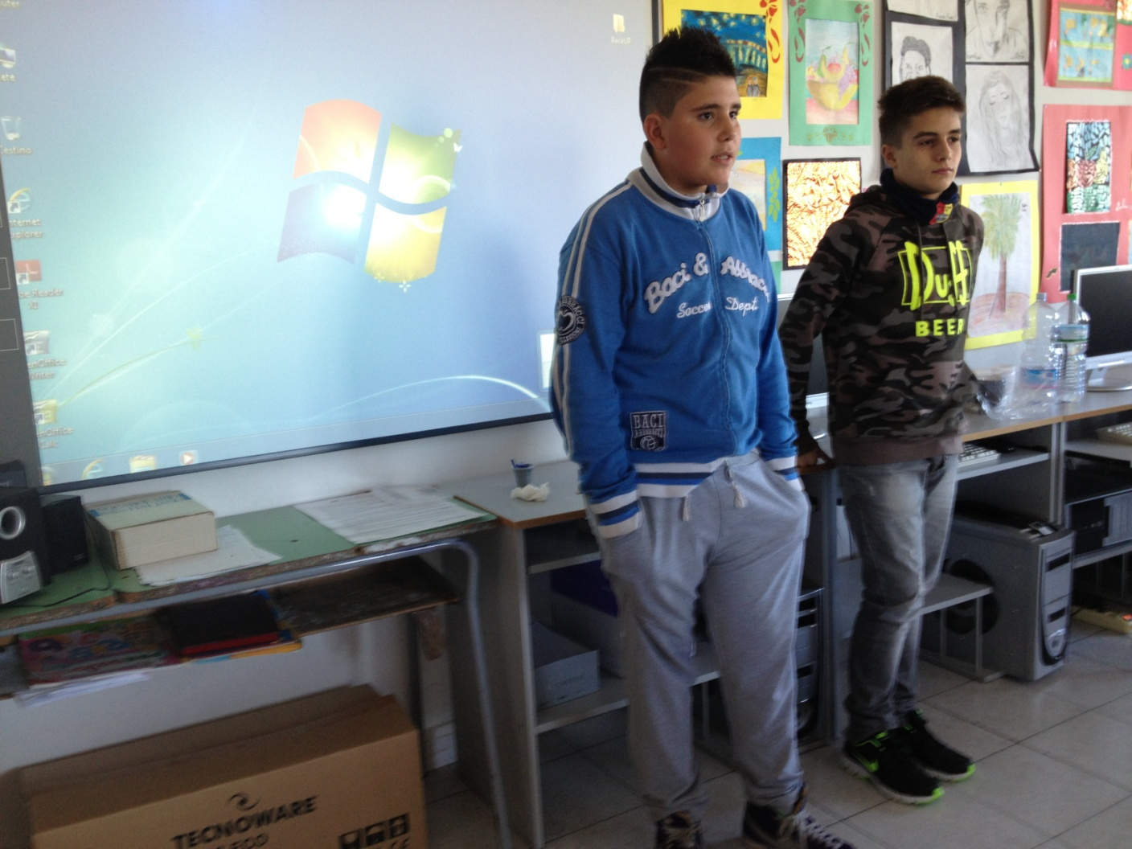
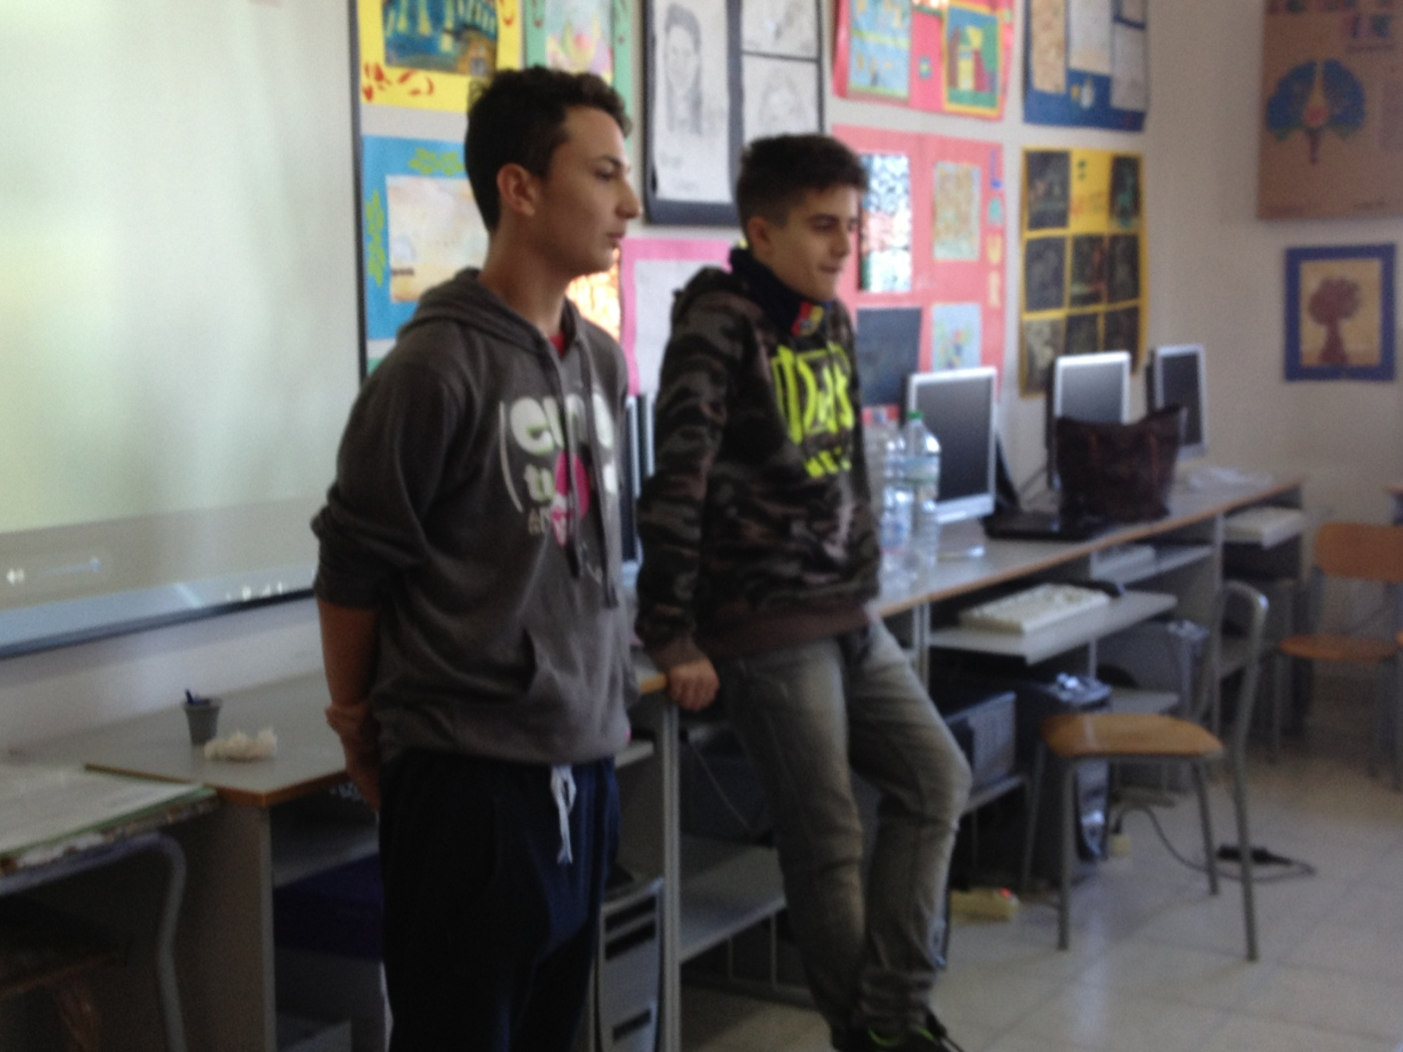
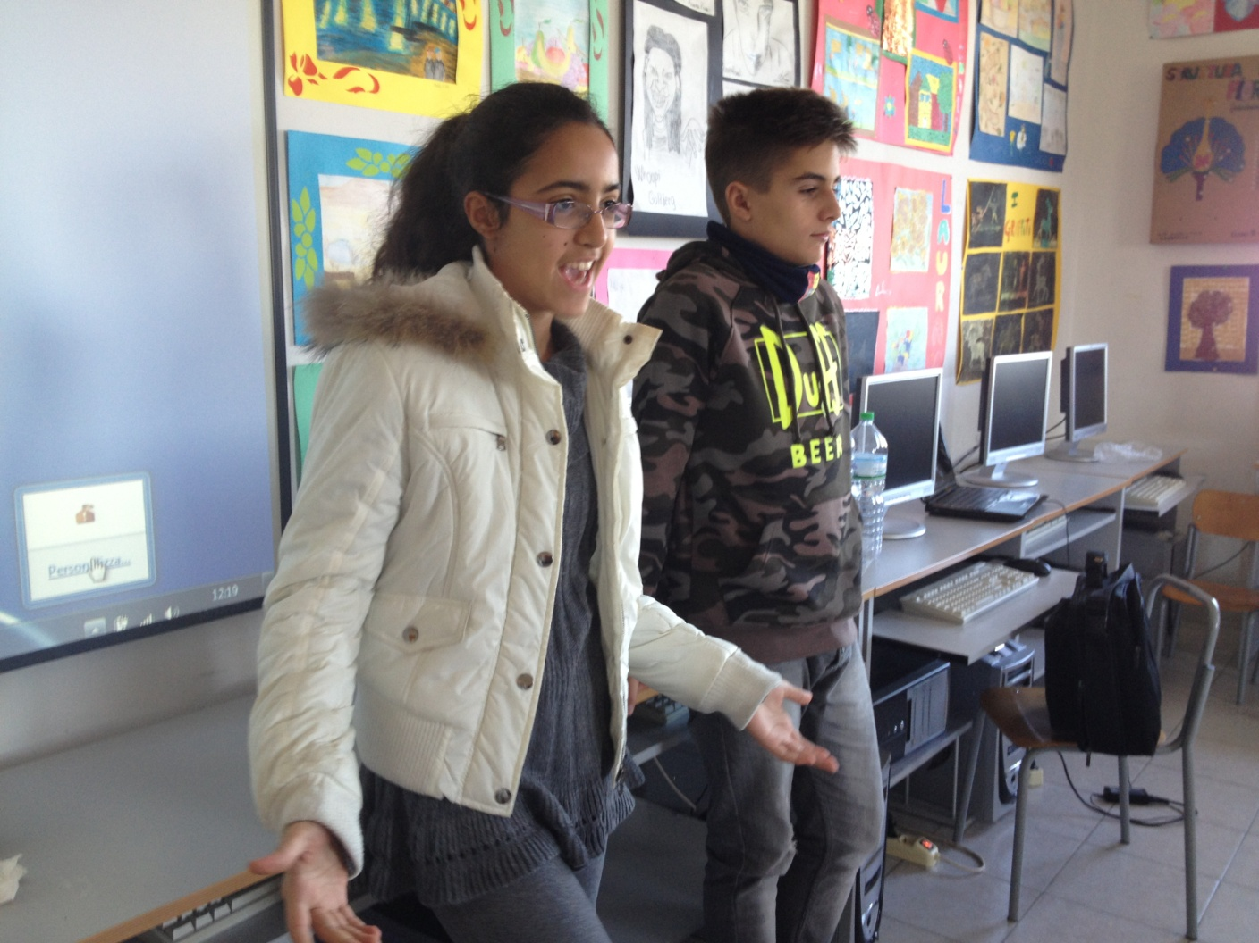

Slide 14
Exhibition of the works
about Holocaust

Slide 15
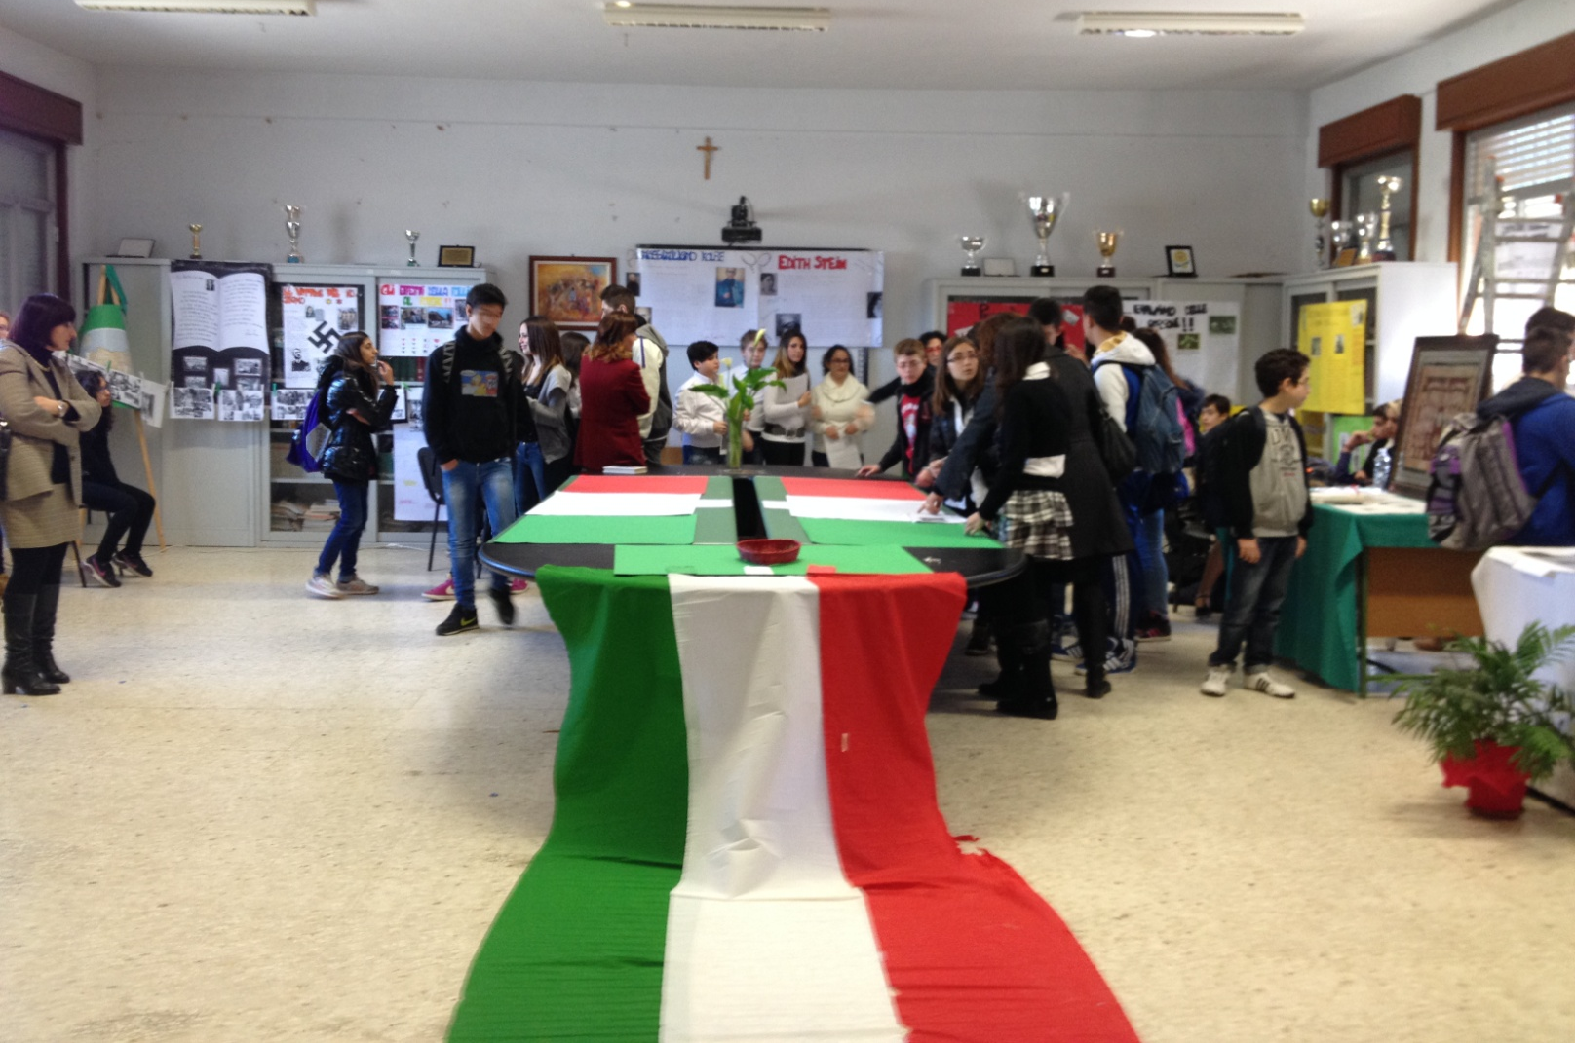
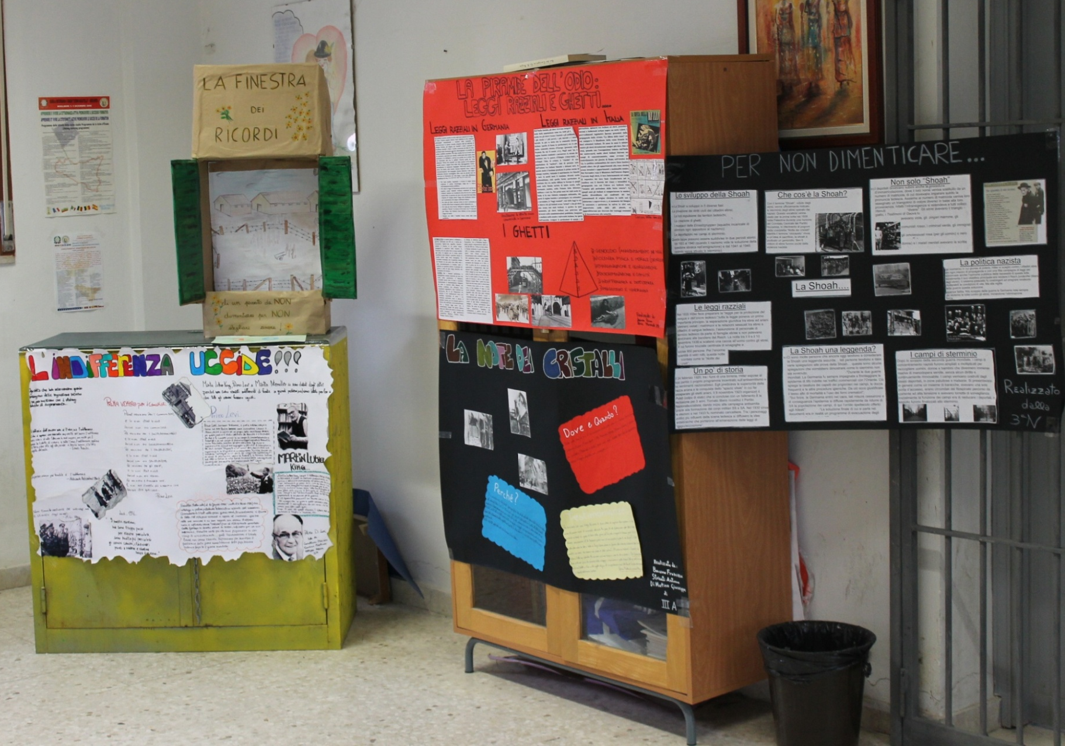
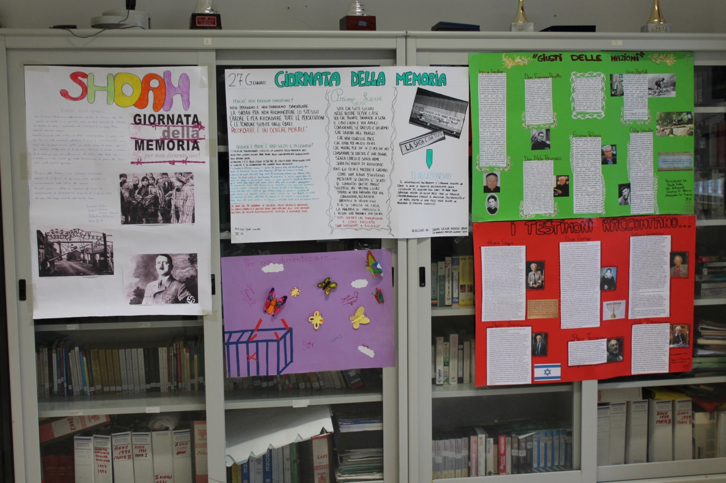

Slide 16
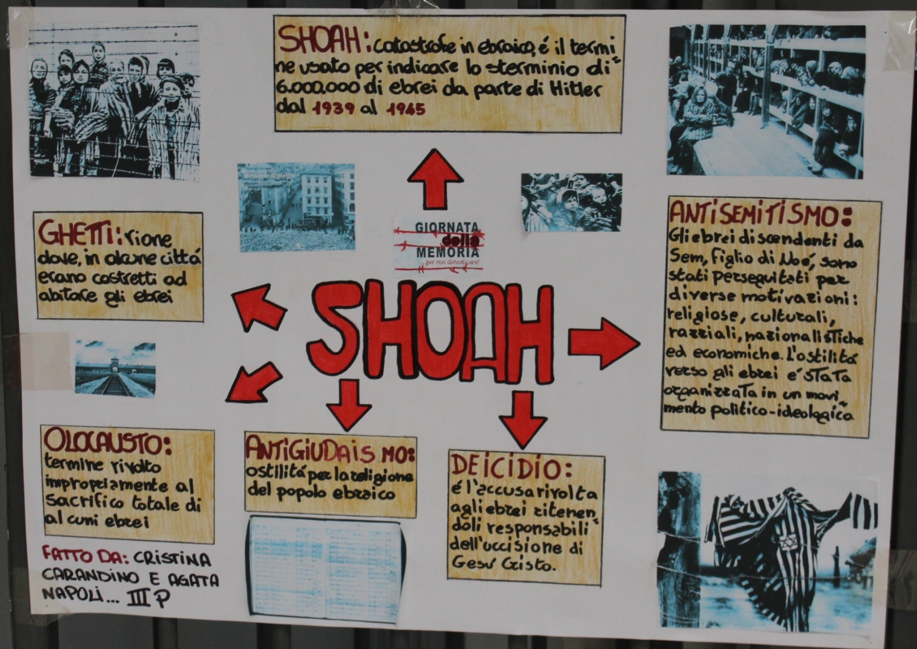

Slide 17
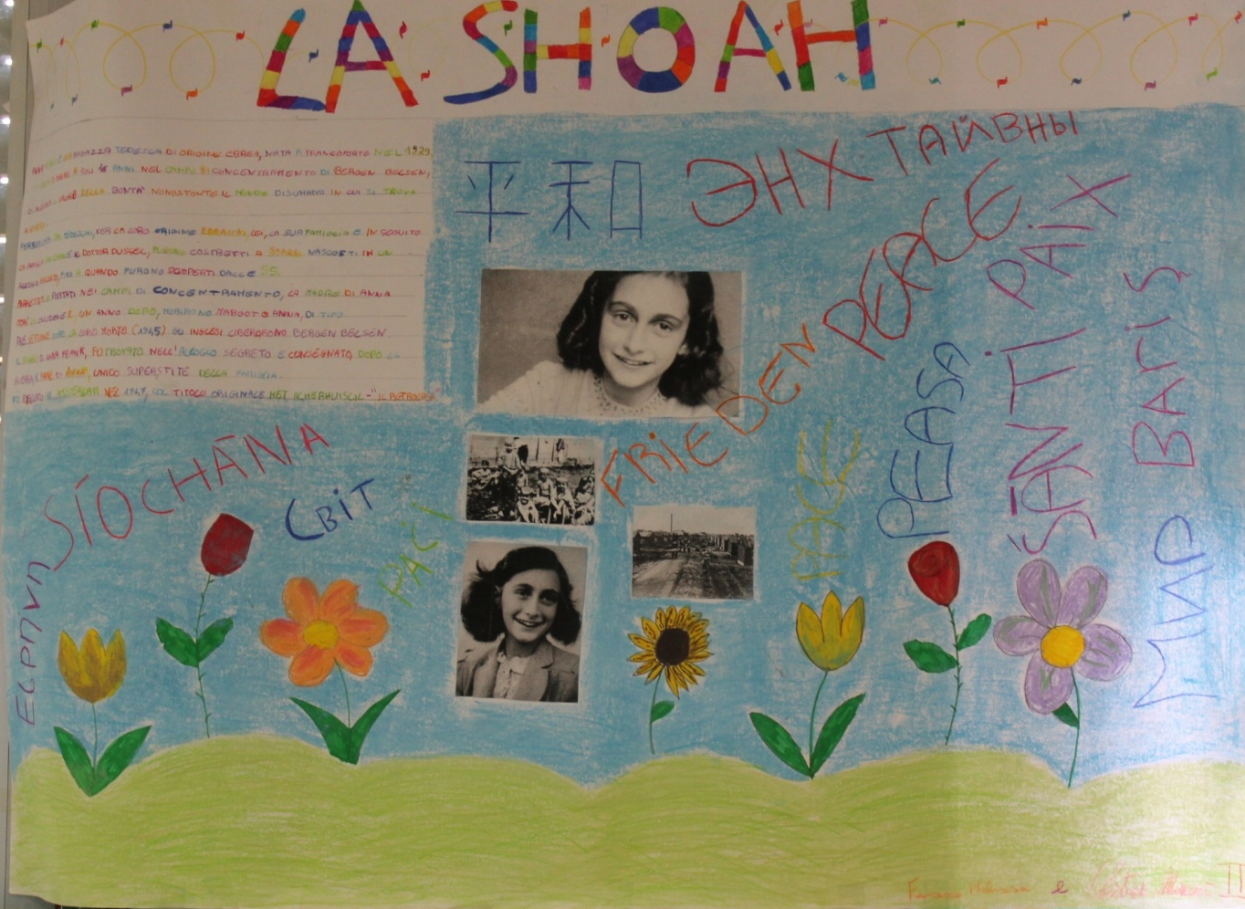

Slide 18
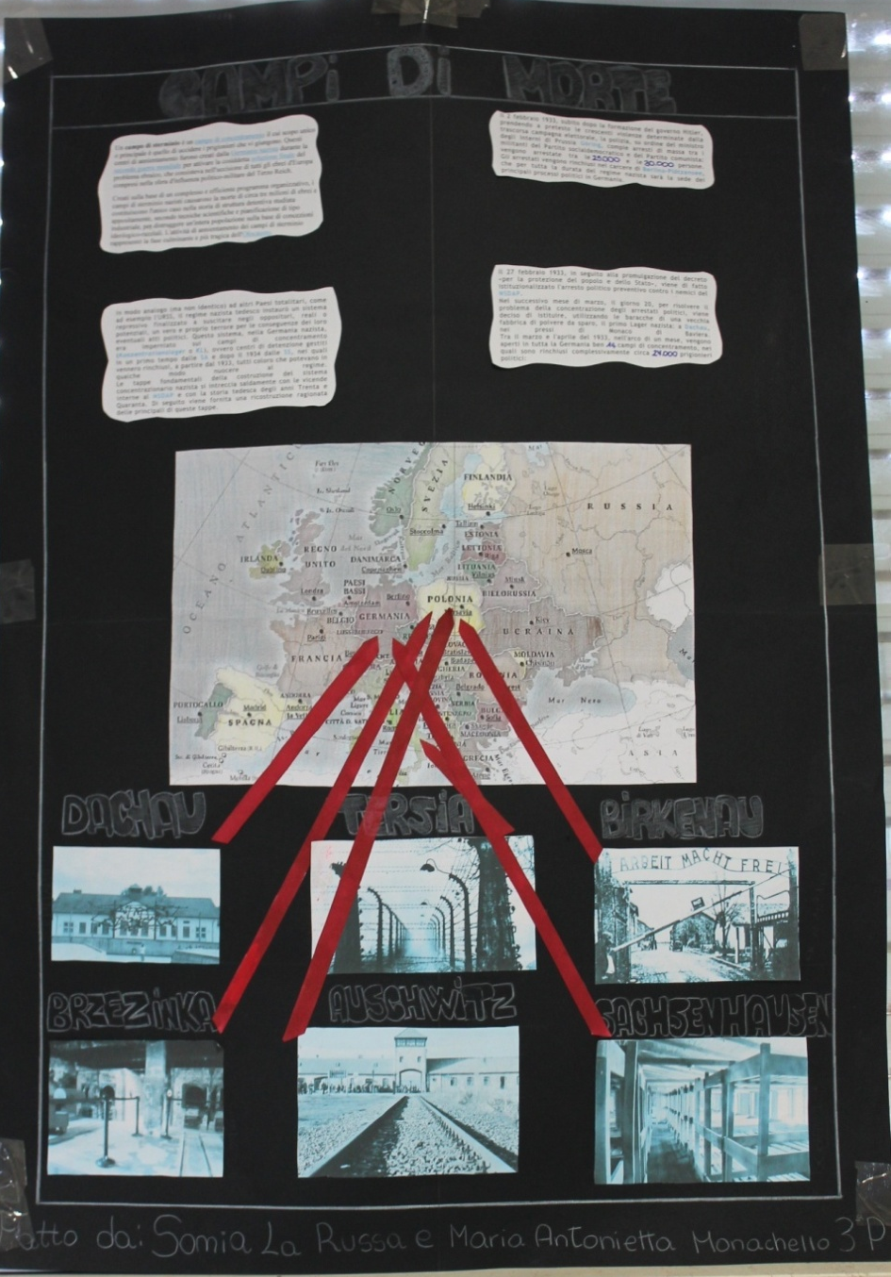

Slide 19
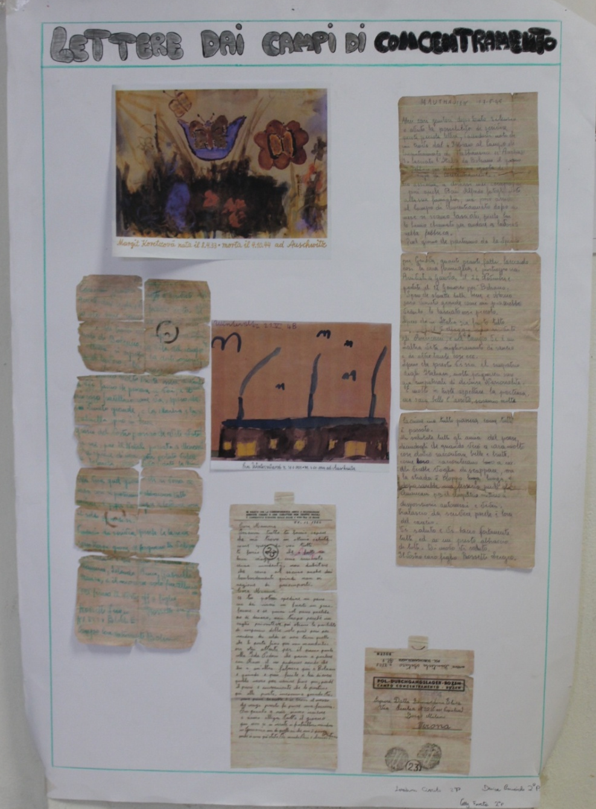

Slide 20
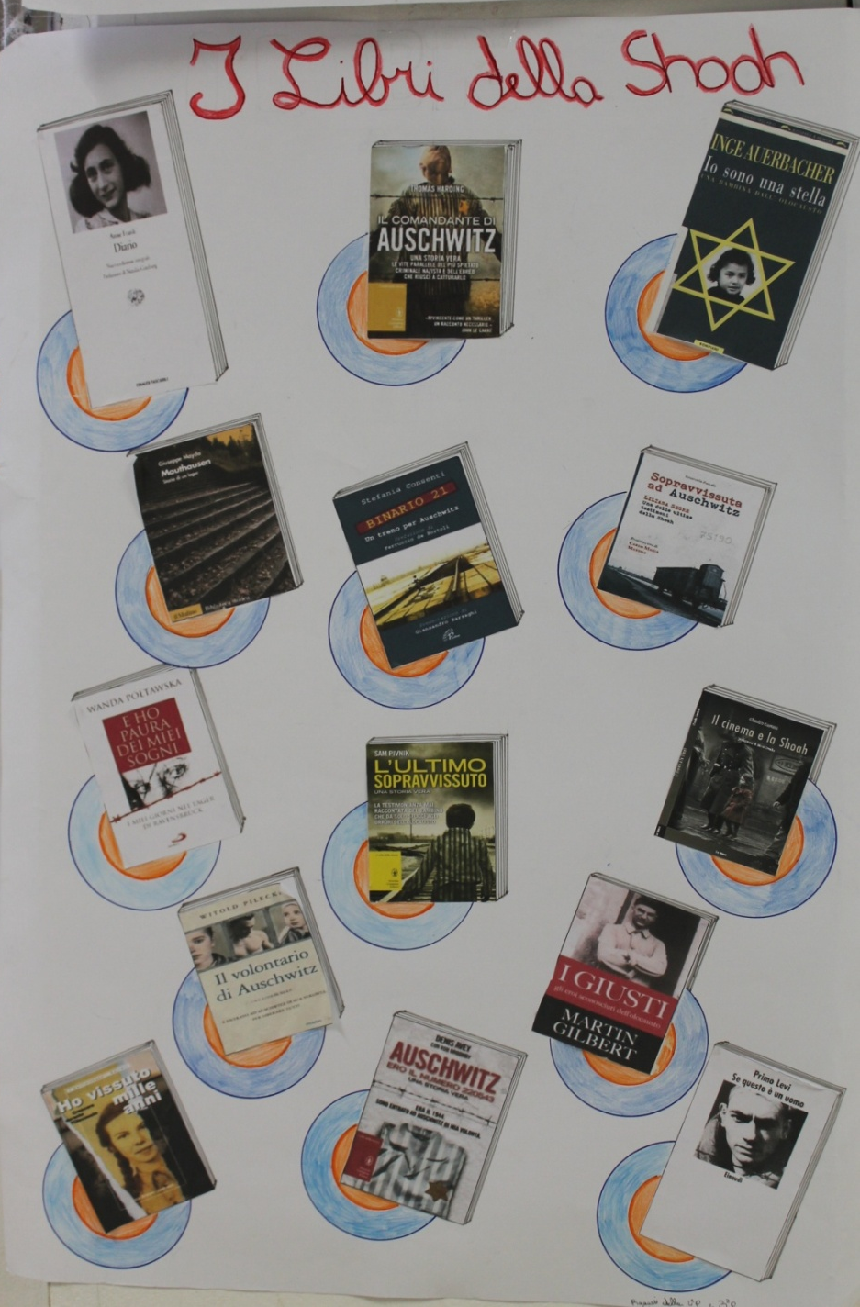

Slide 21
Meetings
with “Libera” and “Sicilitudine” associations
about legality

Slide 22
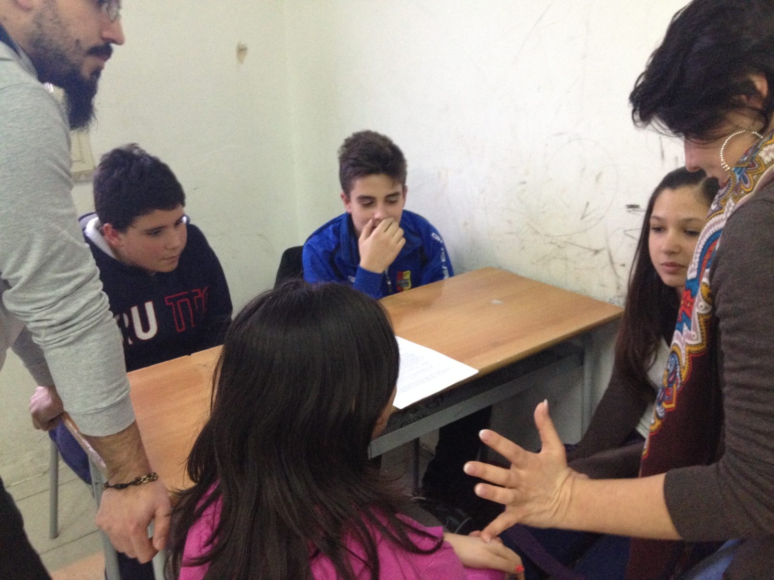
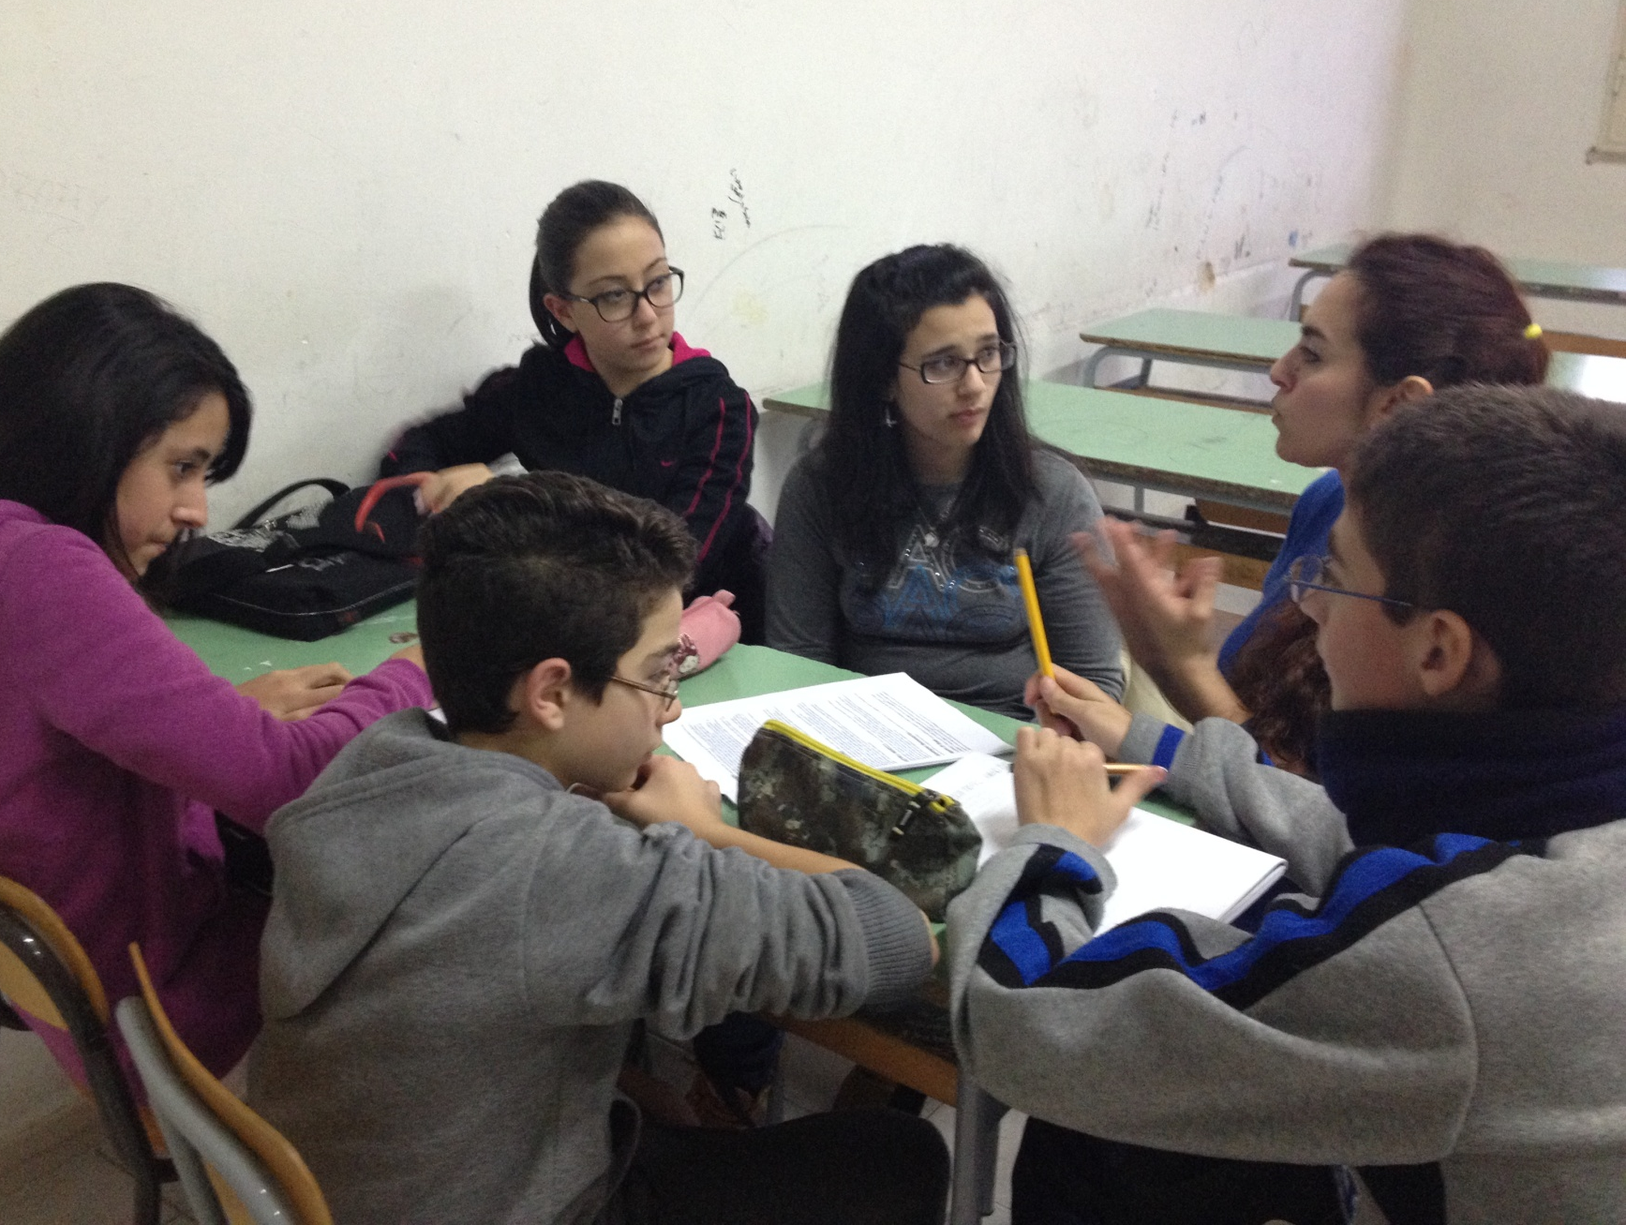

Slide 24
21/03/2014
Nineteenth Day of Remembrance
and commitment to remember the innocent victims of mafia

Slide 27
Skype connection with Klaipeda

Slide 28
Spring of Sciences

Slide 32
and more …
Prof.ssa Tiziana Calà

